Slide 1


ABHIJIT DAS
August 2024

Slide 2

Outline
Executive Summary
Introduction
Methodology
Results
Conclusion
Appendix

Slide 3
Executive Summary
Summary of methodologies: In this project, we will predict if the Falcon 9 first stage will land successfully.
The methodologies employed include:
Data Sourcing using API calls and Web scraping
Data Wrangling
Exploratory Data Analysis using Visualization Libraries and SQL
Building Dashboards using Folium, Dash and Plotly
Machine Learning Algorithms for classification Problem in hand
Summary of all results : Decision Tree purportedly is the best ML Algorithm to predict the outcome. This follows from looking at the evaluation metrics of all ML Algorithms in the Jupyter Notebook.

Slide 4
Introduction
Project background and context
In this capstone, we will predict if the Falcon 9 first stage will land successfully. SpaceX advertises Falcon 9 rocket launches on its website, with a cost of 62 million dollars; other providers cost upward of 165 million dollars each, much of the savings is because SpaceX can reuse the first stage. Therefore, if we can determine if the first stage will land, we can determine the cost of a launch. This information can be used if an alternate company wants to bid against SpaceX for a rocket launch.
Problems you want to find answers
Utilize machine learning algorithms to build a predictive model to help answer the above question in hand

Slide 5

Section 1

Slide 6
Methodology
Executive Summary
Data collection methodology: CRISP – DM (API & Web Scrapping)
Perform data wrangling: Using Pandas and Numpy Library Functions
Perform exploratory data analysis (EDA) using: Visualization and SQL
Perform interactive visual analytics using: Folium, Plotly and Dash
Perform predictive analysis using classification models: SVM, Decision Trees, KNN and Logistic Regression

Slide 7
Data Collection
Describe how data sets were collected.
Data sets were primarily collected using API calls and Web scrapping
You need to present your data collection process use key phrases and flowcharts
Convert a JSON file into a Python Pandas data frame
Develop Python code to manipulate data in a Pandas data frame
Utilize data analysis tools to load a dataset, clean it, and find insights from it using Pandas, Numpy , BeautifulSoup and SciPy Library functions

Slide 8
Data Collection – SpaceX API
Present your data collection with SpaceX REST calls using key phrases and flowcharts
Request to the SpaceX API
Clean the requested data
Add the GitHub URL of the completed SpaceX API calls notebook (must include completed code cell and outcome cell), as an external reference and peer-review purpose
https://github.com/1abhijitdas1/IBMDataScience/blob/61c43b7231f5ca0c74a54ad678b1c5acc75d74a5/jupyter-labs-spacex-data-collection-api.ipynb

Slide 9
Data Collection - Scraping
Present your web scraping process using key phrases and flowcharts
Extract a Falcon 9 launch records HTML table from Wikipedia
Parse the table and convert it into a Pandas data frame
Add the GitHub URL of the completed web scraping notebook, as an external reference and peer-review purpose
https://github.com/1abhijitdas1/IBMDataScience/blob/61c43b7231f5ca0c74a54ad678b1c5acc75d74a5/jupyter-labs-webscraping.ipynb

Slide 10
Data Wrangling
In this, we will perform some Exploratory Data Analysis (EDA) to find some patterns in the data and determine what would be the label for training supervised models.
In the data set, there are several different cases where the booster did not land successfully. Sometimes a landing was attempted but failed due to an accident; for example, True Ocean means the mission outcome was successfully landed to a specific region of the ocean while False Ocean means the mission outcome was unsuccessfully landed to a specific region of the ocean. True RTLS means the mission outcome was successfully landed to a ground pad False RTLS means the mission outcome was unsuccessfully landed to a ground pad. True ASDS means the mission outcome was successfully landed on a drone ship False ASDS means the mission outcome was unsuccessfully landed on a drone ship.
We will mainly convert those outcomes into Training Labels with 1 means the booster successfully landed 0 means it was unsuccessful.
https://github.com/1abhijitdas1/IBMDataScience/blob/61c43b7231f5ca0c74a54ad678b1c5acc75d74a5/labs-jupyter-spacex-Data%20wrangling.ipynb

Slide 11
EDA with Data Visualization
Visualize the relationship between Flight Number and Launch Site
Visualize the relationship between Payload Mass and Launch Site
Visualize the relationship between success rate of each orbit type
Visualize the relationship between Flight Number and Orbit type
Visualize the relationship between Payload Mass and Orbit type
Visualize the launch success yearly trend
Create dummy variables to categorical columns
https://github.com/1abhijitdas1/IBMDataScience/blob/61c43b7231f5ca0c74a54ad678b1c5acc75d74a5/edadataviz.ipynb

Slide 12
EDA with SQL
Understand the Spacex DataSet
Load the dataset into the corresponding table in a SQL Lite database
Use SQL Magic in Notebook
https://github.com/1abhijitdas1/IBMDataScience/blob/61c43b7231f5ca0c74a54ad678b1c5acc75d74a5/jupyter-labs-eda-sql-coursera_sqllite.ipynb

Slide 13
Build an Interactive Map with Folium
The launch success rate may depend on many factors such as payload mass, orbit type, and so on. It may also depend on the location and proximities of a launch site, i.e., the initial position of rocket trajectories. Finding an optimal location for building a launch site certainly involves many factors and hopefully we could discover some of the factors by analyzing the existing launch site locations. In exploratory data analysis labs, we have visualized the SpaceX launch dataset using matplotlib and seaborn and discovered some preliminary correlations between the launch site and success rates. Here, we will be performing more interactive visual analytics using Folium.
https://github.com/1abhijitdas1/IBMDataScience/blob/61c43b7231f5ca0c74a54ad678b1c5acc75d74a5/lab_jupyter_launch_site_location.ipynb

Slide 14
Build a Dashboard with Plotly Dash
Build an interactive dashboard that contains pie charts and scatter plots to analyze data with the Plotly Dash Python library.
Build a dashboard to analyze launch records interactively with Plotly Dash.
https://github.com/1abhijitdas1/IBMDataScience/blob/61c43b7231f5ca0c74a54ad678b1c5acc75d74a5/Build%20an%20Interactive%20Dashboard%20with%20Ploty%20Dash.txt

Slide 15
Predictive Analysis (Classification)
Perform exploratory Data Analysis and determine Training Labels
create a column for the class
Standardize the data
Split into training data and test data
-Find best Hyperparameter for SVM, Classification Trees and Logistic Regression
Find the method performs best using test data
https://github.com/1abhijitdas1/IBMDataScience/blob/61c43b7231f5ca0c74a54ad678b1c5acc75d74a5/SpaceX_Machine%20Learning%20Prediction.ipynb

Slide 16
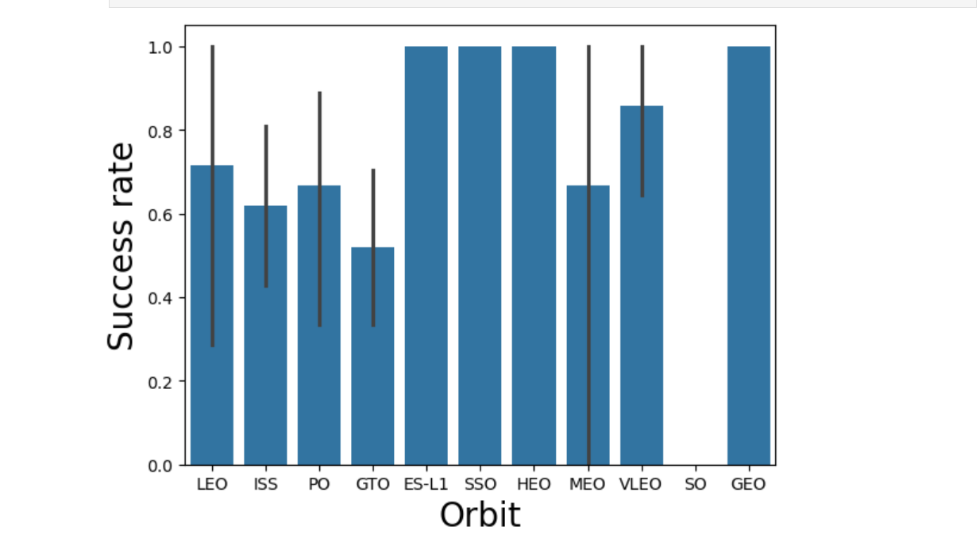
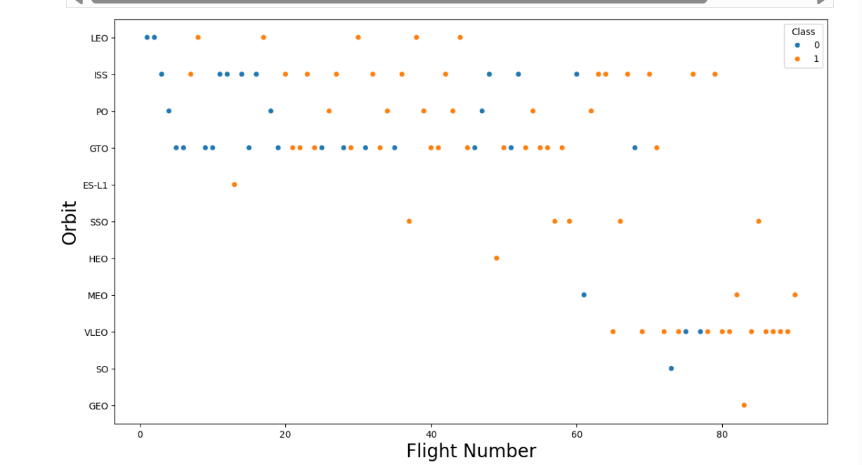
Results - EDA

Slide 17
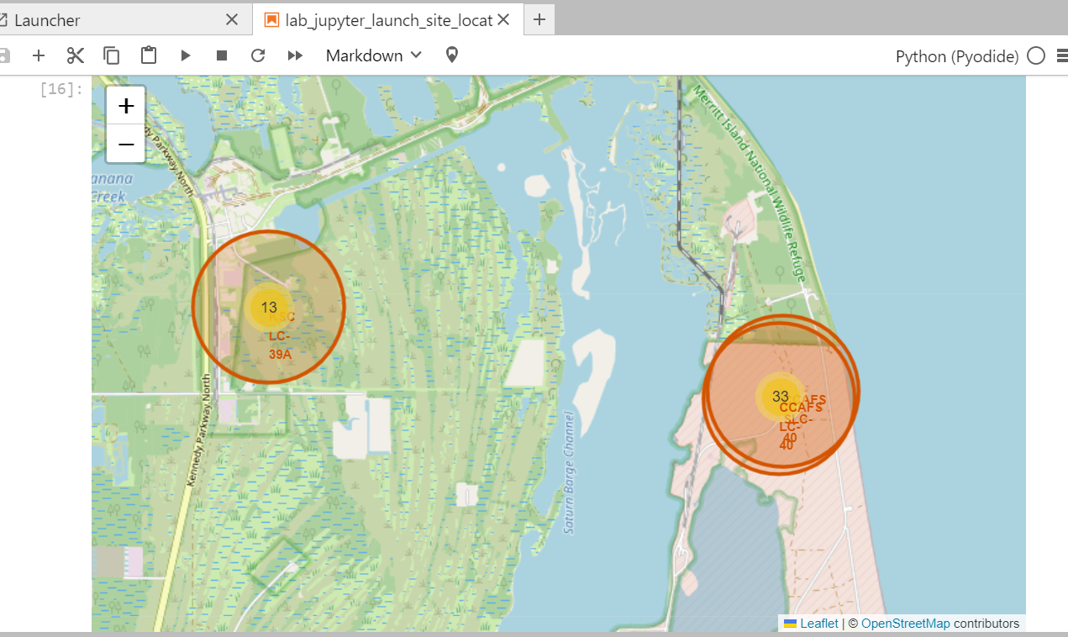
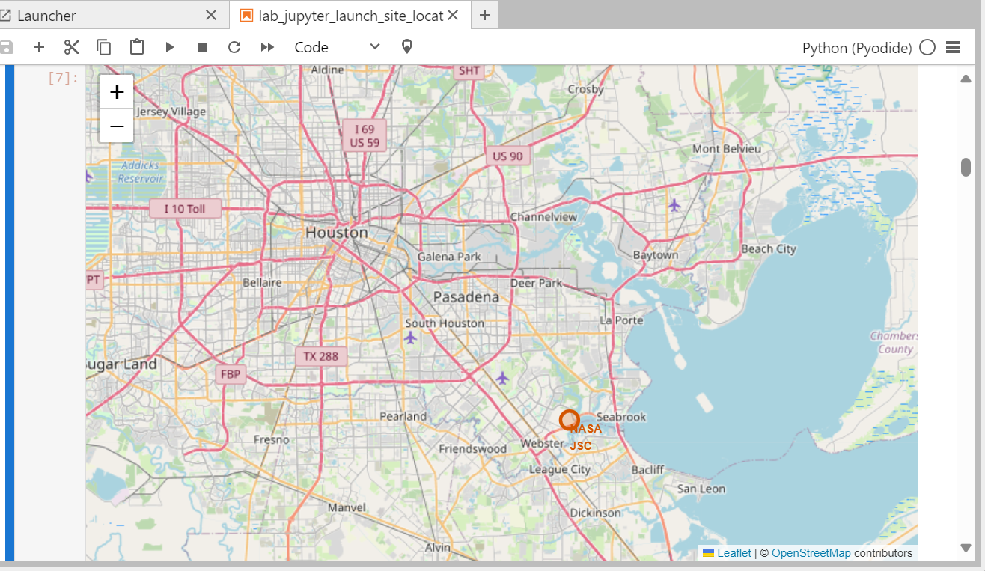
Results - Folium

Slide 18
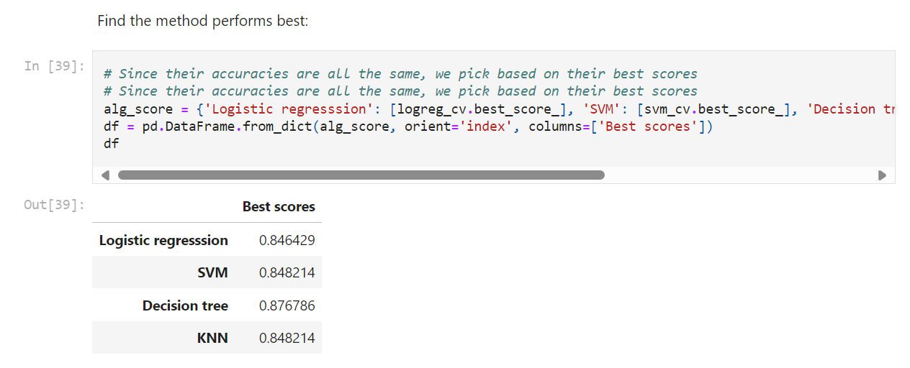
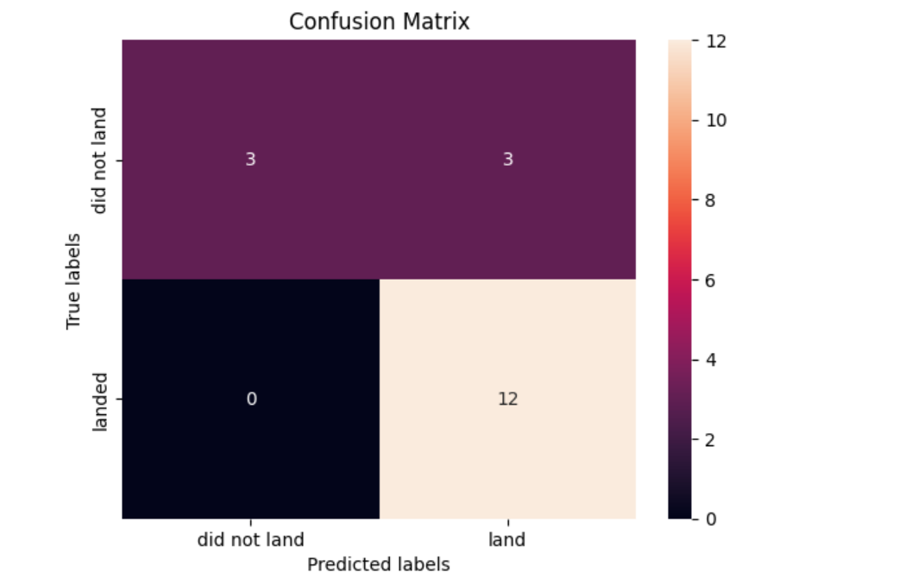
Results – ML Classification

Slide 19

Section 2

Slide 20
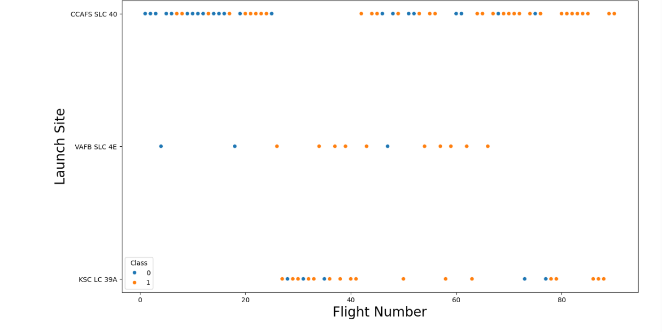
Flight Number vs. Launch Site

Slide 21
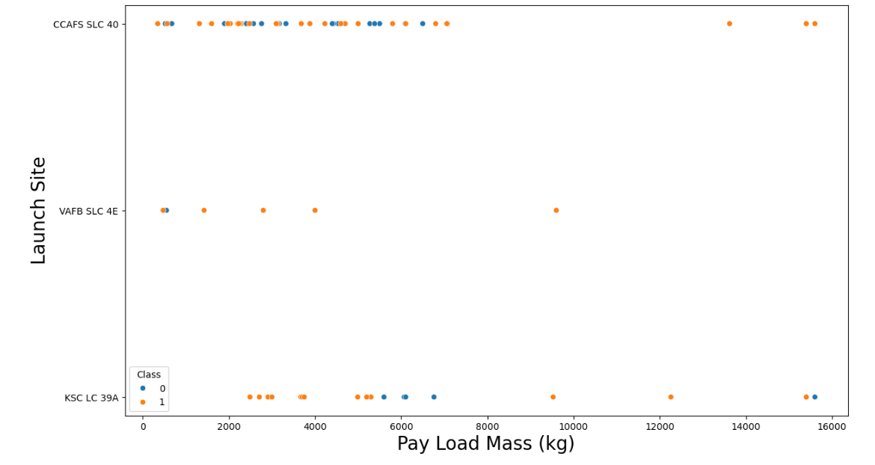
Payload vs. Launch Site

Slide 22
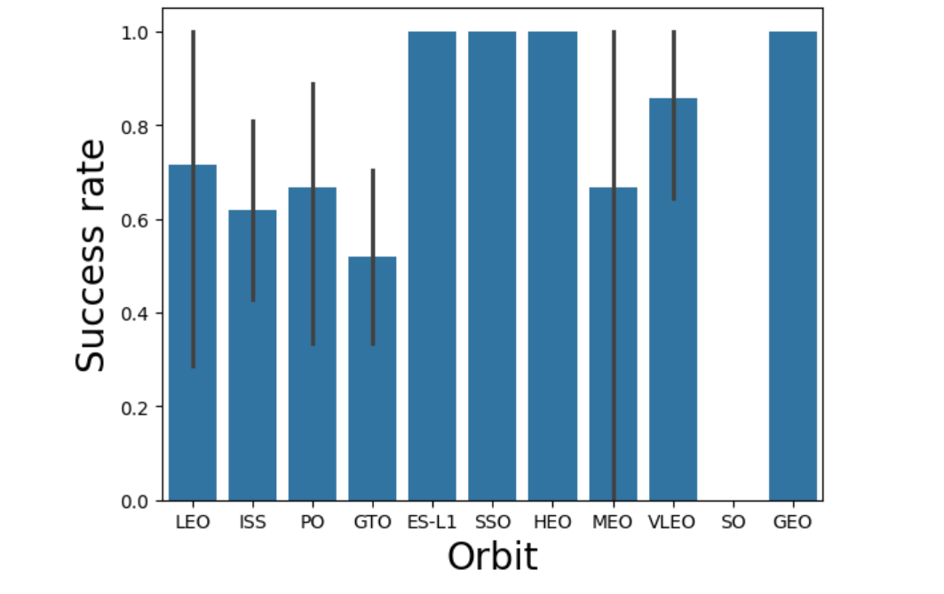
Success Rate vs. Orbit Type

Slide 23
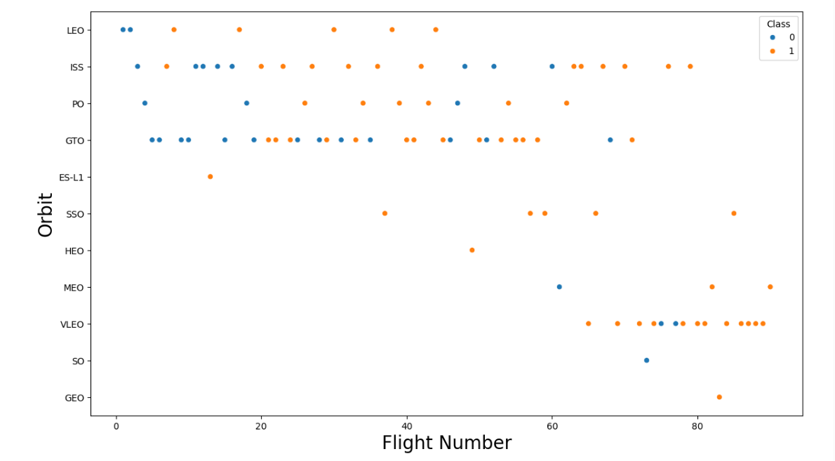
Flight Number vs. Orbit Type

Slide 24
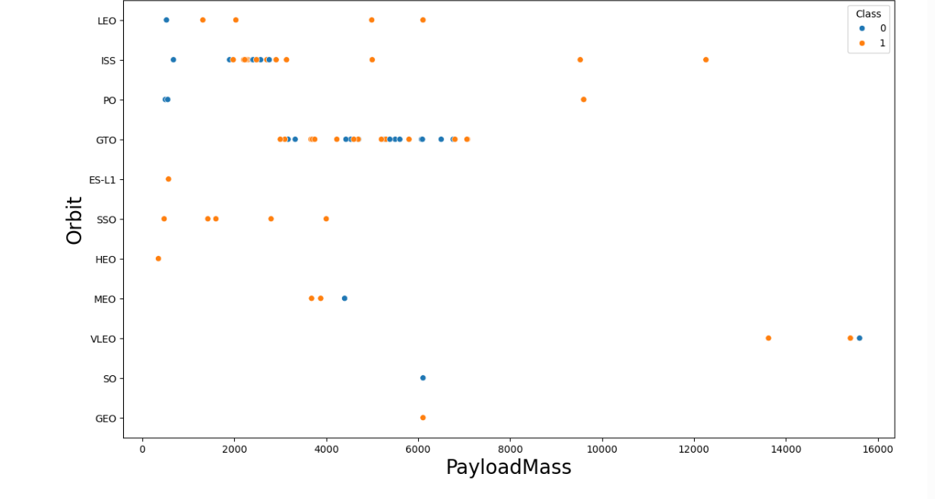
Payload vs. Orbit Type

Slide 25
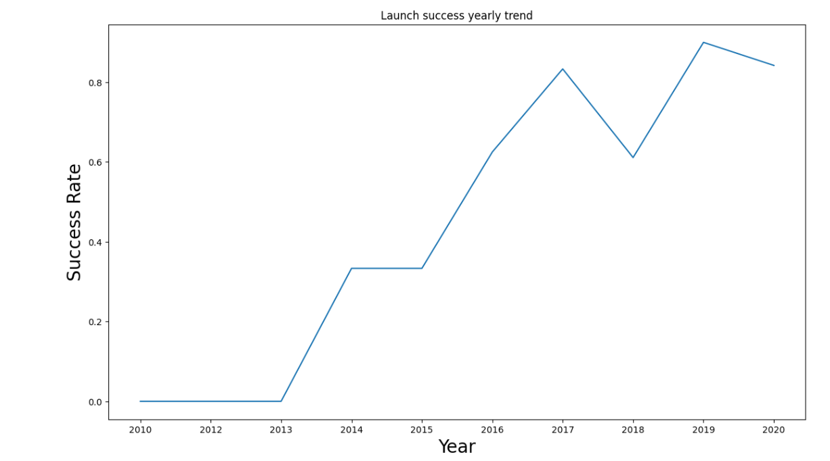
Launch Success Yearly Trend

Slide 26
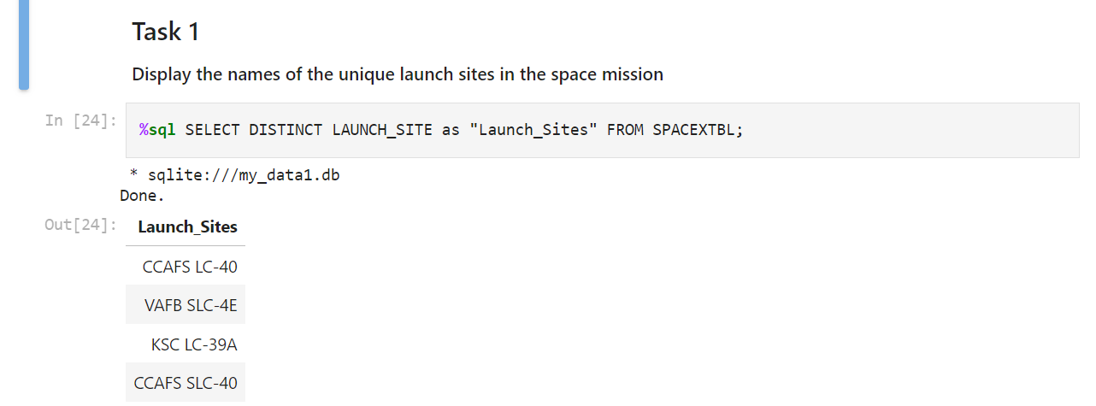
All Launch Site Names

Slide 27
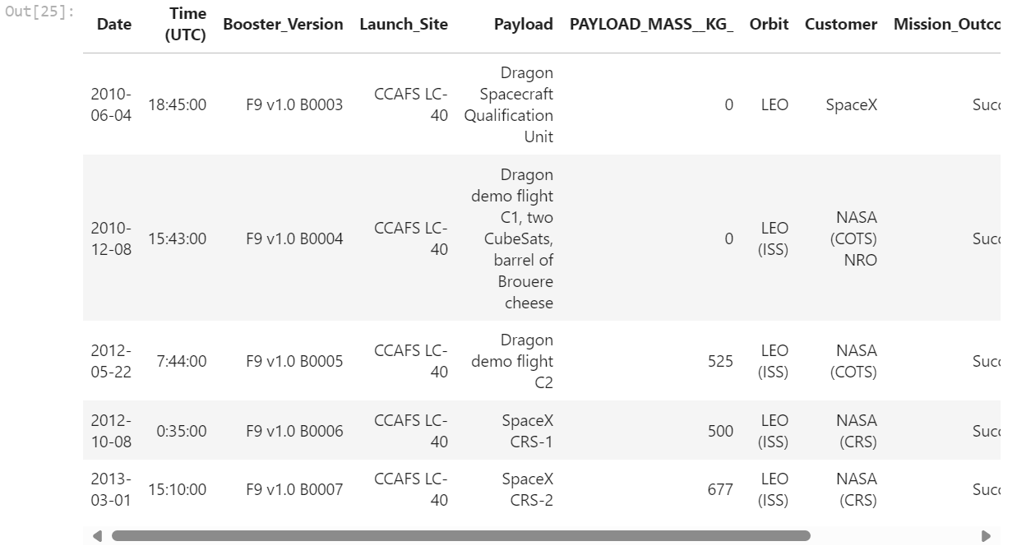
Launch Site Names Begin with 'CCA'

Slide 28
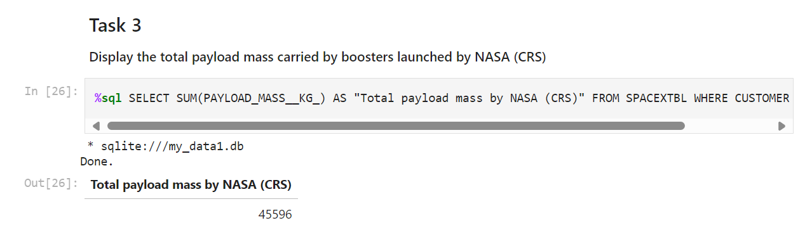
Total Payload Mass

Slide 29
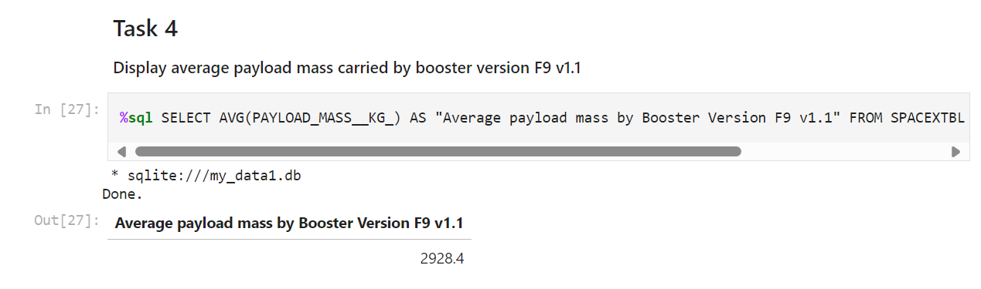
Average Payload Mass by F9 v1.1

Slide 30
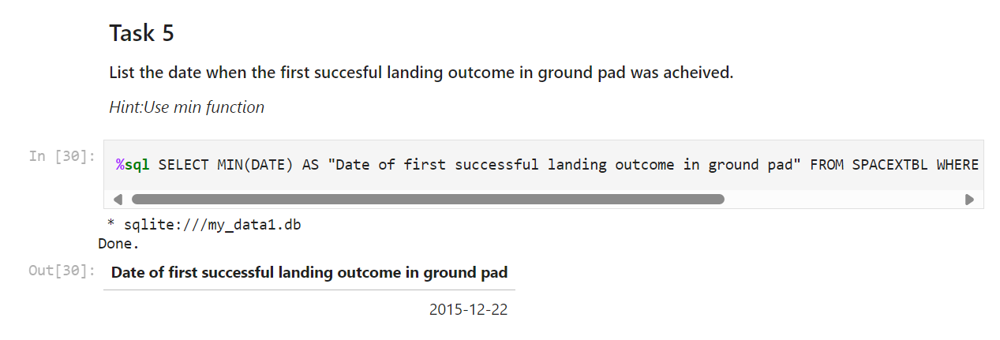
First Successful Ground Landing Date

Slide 31
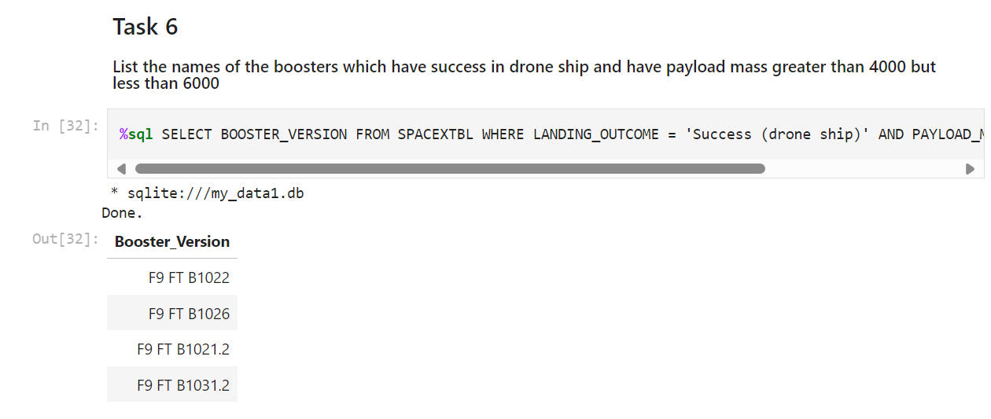
Successful Drone Ship Landing with Payload between 4000 and 6000

Slide 32
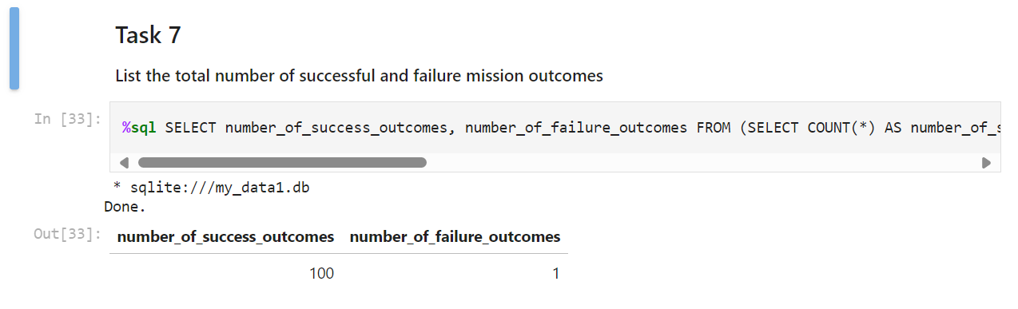
Total Number of Successful and Failure Mission Outcomes

Slide 33
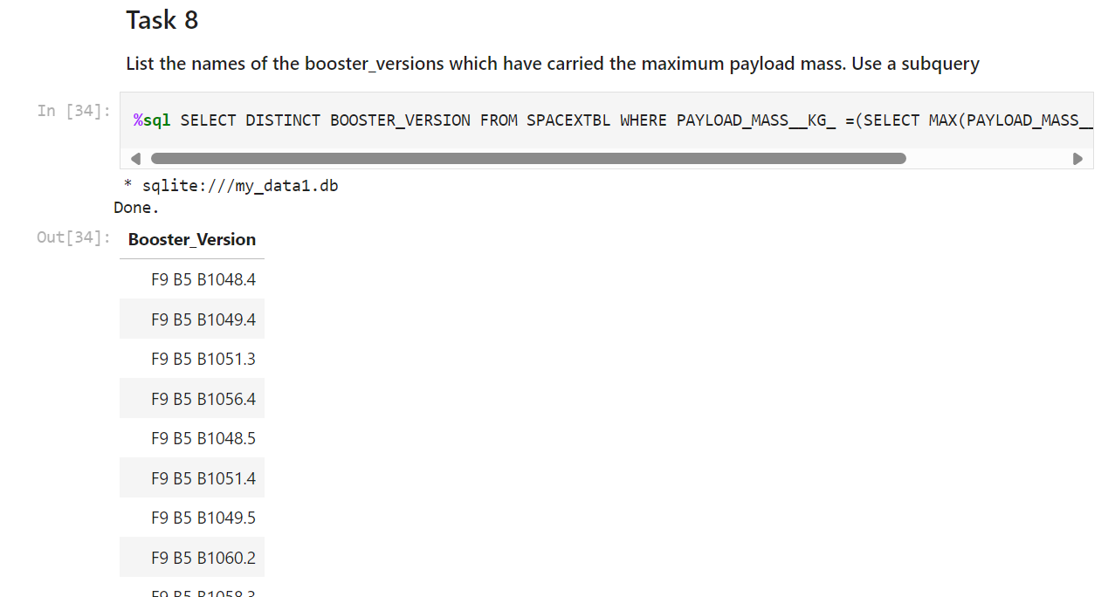
Boosters Carried Maximum Payload

Slide 34
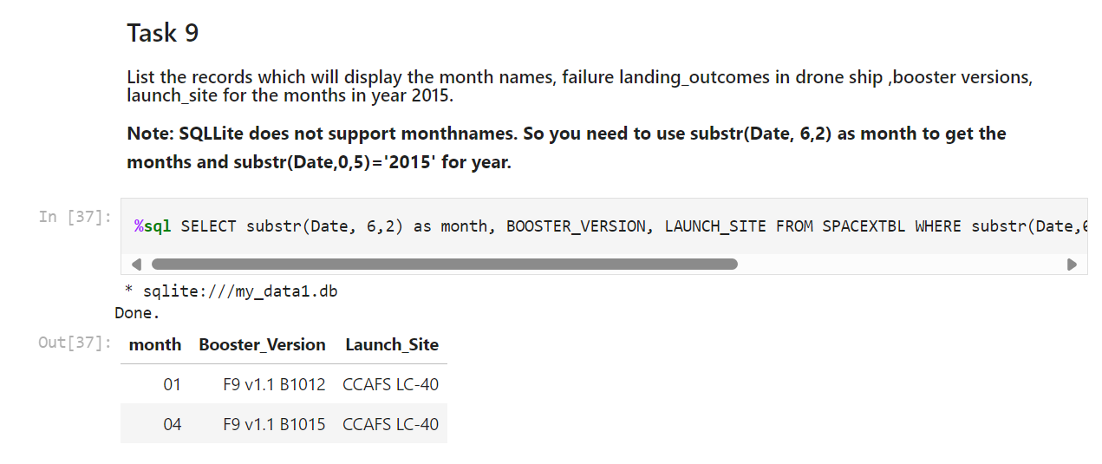
2015 Launch Records

Slide 35
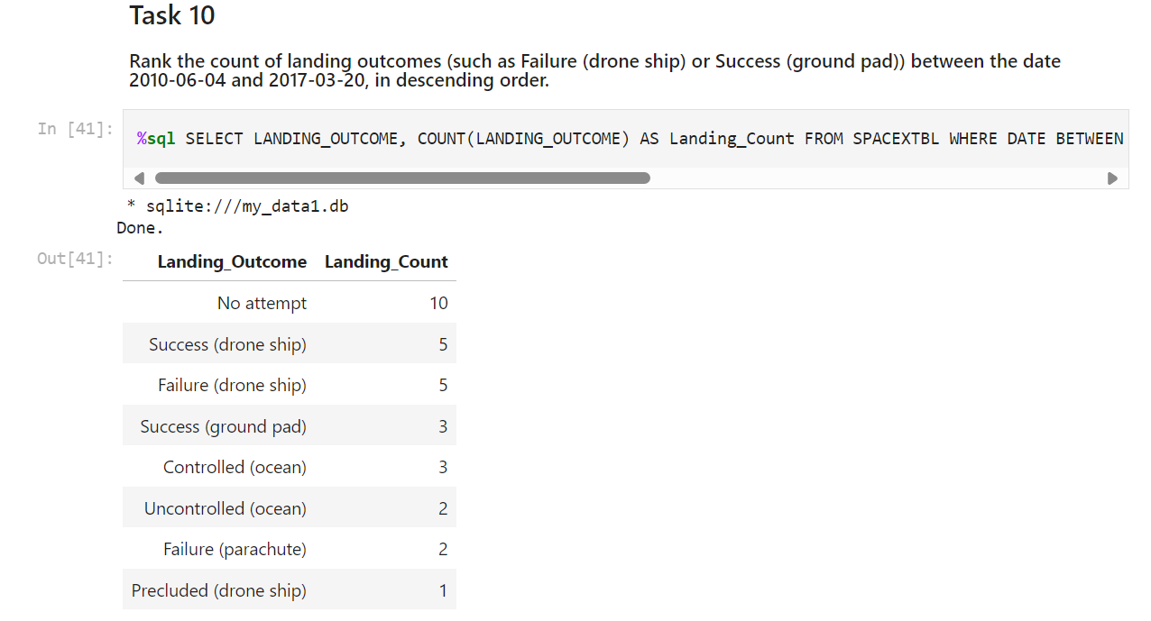
Rank Landing Outcomes Between 2010-06-04 and 2017-03-20

Slide 36

Section 3

Slide 37
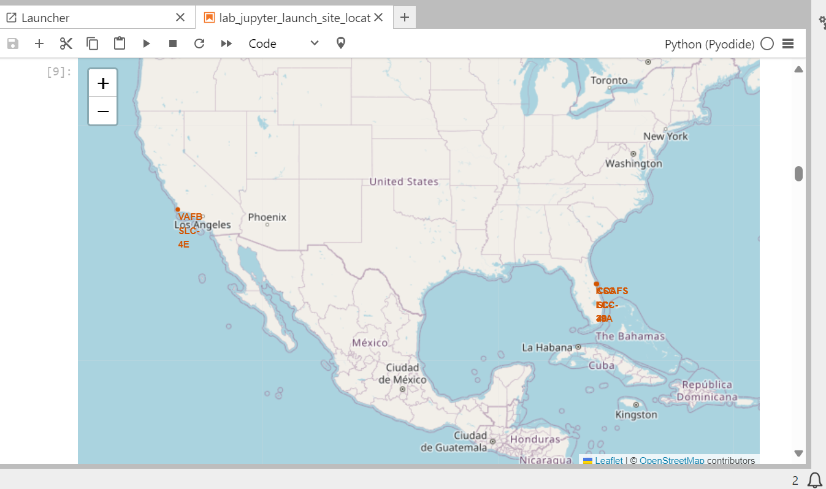
<Folium Map Screenshot 1>

Slide 38
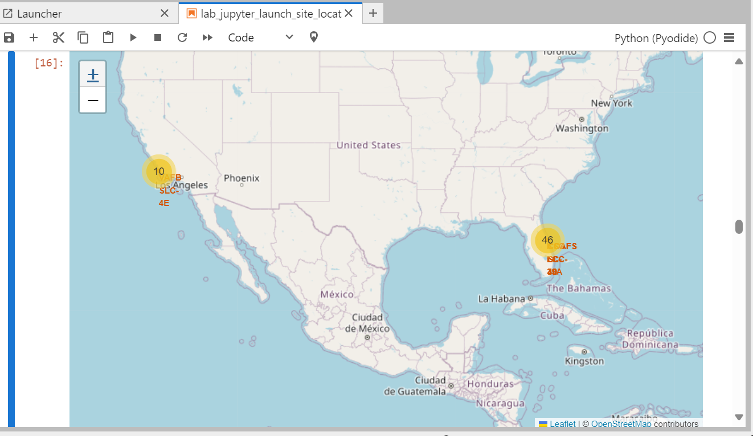
<Folium Map Screenshot 2>

Slide 39
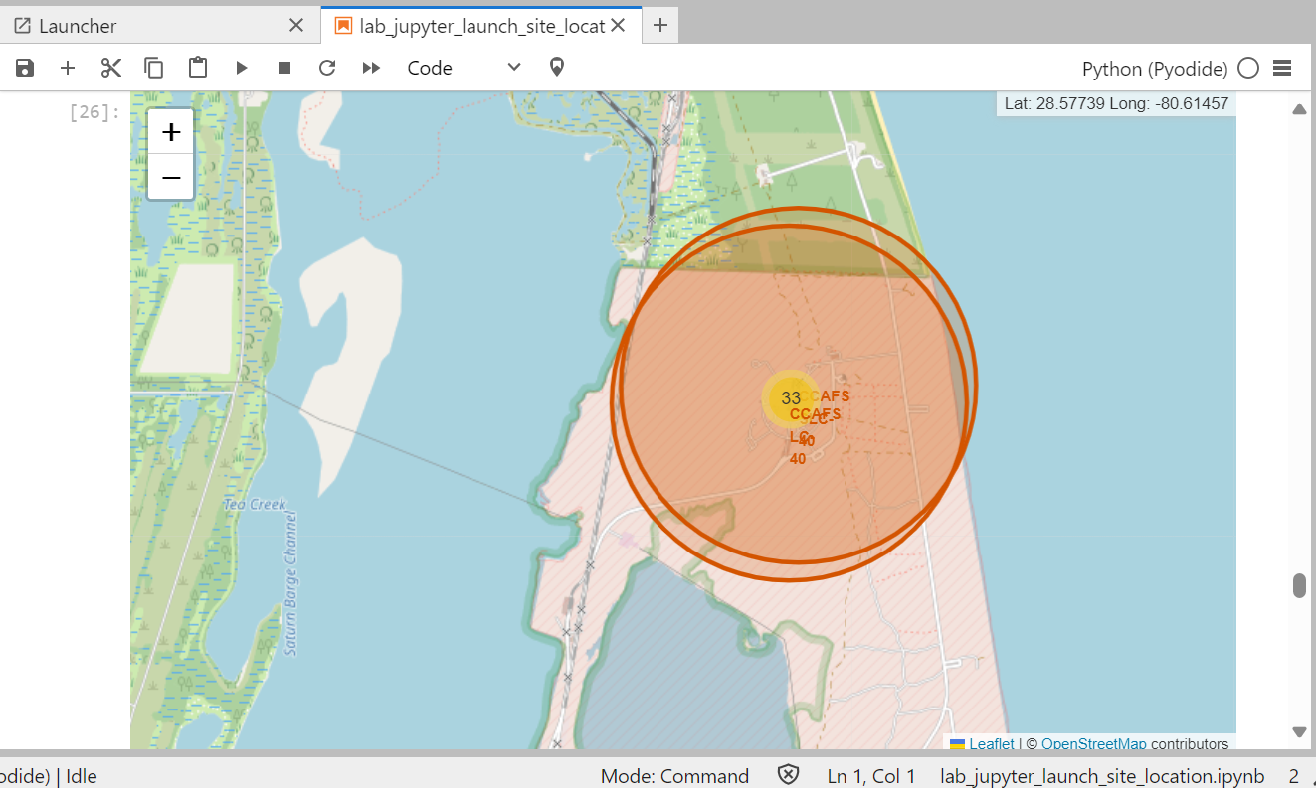
<Folium Map Screenshot 3>

Slide 40

Section 4

Slide 41
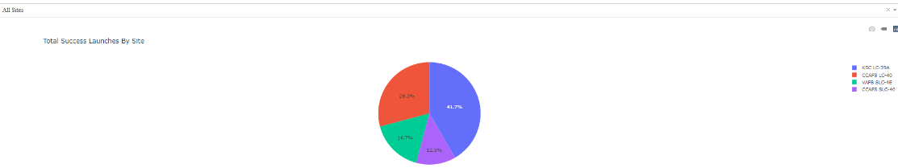
<Dashboard Screenshot 1>

Slide 42
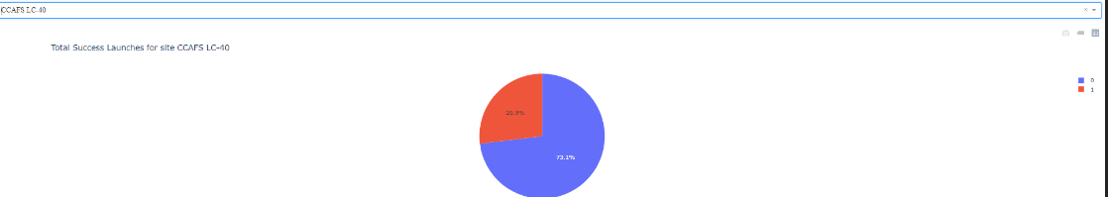
<Dashboard Screenshot 2>

Slide 43
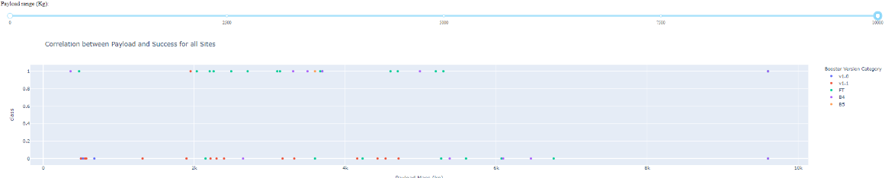
<Dashboard Screenshot 3>

Slide 44

Section 5

Slide 45
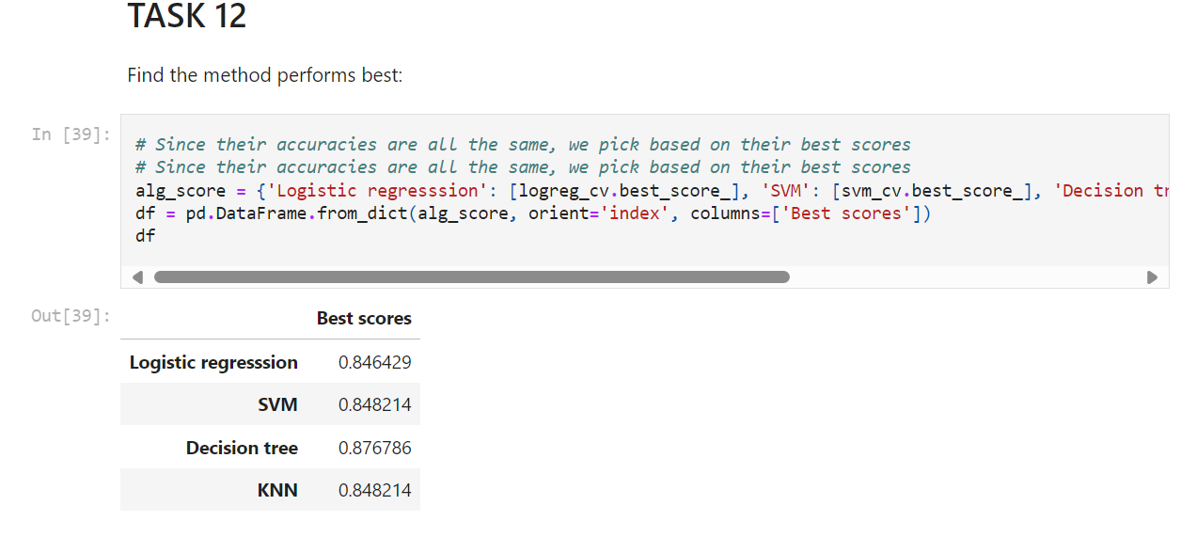
Classification Accuracy

Slide 46
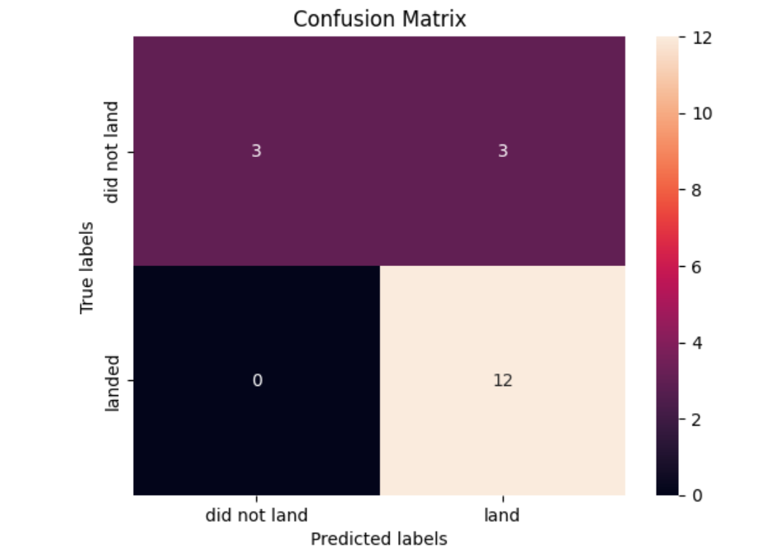
Confusion Matrix for Decision Tree

Slide 47
Conclusions
“Decision Tree purportedly is the best ML Algorithm to predict the outcome. This follows from looking at the evaluation metrics of all ML Algorithms in the Jupyter Notebook”

Slide 48
Appendix
GIT HUB link to Labs: 1abhijitdas1/IBMDataScience: CapstoneProjectFiles (github.com)

Slide 49


